Slide 1



Chartbook:
The Oral Health of
Los Angeles County’s
Residents
LA County Department of Public Health
Oral Health Program
May 2026
Funded by the Office of Oral Health,
California Department of Public Health,
Contract #22-10173

Slide 2
Introduction
This chartbook highlights current data on topics associated with the oral health of LA County’s residents including, but not limited to
  Tooth decay in children and tooth loss in adults
  Oral and pharyngeal (throat) cancer
  Use of the dental care delivery system
  Access to preventive services
  Dental workforce
Each topic area includes graphs with current data and, when available, data on disparities and trends
The chartbook is updated as new data becomes available

Slide 3
Table of Contents
Population | Indicator | Slide Number | Click to go to Slide
Kindergarten & 3rd grade | Decay experience | 7 | Tooth Decay Experience in Children
Kindergarten & 3rd grade | Untreated tooth decay | 10 | Untreated Tooth Decay in Children
3rd grade | Dental sealants | 13 | Dental Sealants in Children
Adolescents 12-17 years | Self-reported condition of teeth | 16 | Condition of Teeth in Adolescents 12-17 Years
Adults 18+ years | Any tooth loss | 20 | Tooth Loss in Adults 18+ Years
Adults 65+ years | Total tooth loss | 23 | Total Tooth Loss in Adults 65+ Years
Adults 18+ years | Self-reported condition of teeth | 26 | Condition of Teeth in Adults 18+ Years
All adults | Oral & pharyngeal cancer | 29 | Oral & Pharyngeal Cancer
Children 1-11 years | Dental visit in last year | 35 | Dental Visit Children 1-11 Years
Adolescents 12-17 years | Dental visit in last year | 38 | Dental Visit Adolescents 12-17 Years
Adults 18+ years | Dental visit in last year | 41 | Dental Visit Adults 18+ Years
Adults 18+ years with diabetes | Dental visit in last year | 44 | Dental Visit Adults 18+ Years with Diabetes
Pregnant women | Dental visit in last year | 46 | Dental Visit Pregnant Women
Medicaid (Medi-Cal) enrollees | Dental visit in last year | 50 | Dental Visit Medicaid (Medi-Cal) Enrollees
Children 1-11 years | Used free community or public dental clinic | 53 | Use of Free/Public Dental Clinics Children 1-11 Years
Children & Adolescents 5-17 years | Missed school because of dental problems | 58 | Missed School Because of Dental Problems
Children 1-11 years | Could not access needed care because of cost | 61 | Could Not Afford Needed Care Children 1-11 Years

Slide 4
Table of Contents (Continued)
Population | Indicator | Slide Number | Click to go to Slide
Children 1-11 years | Dental insurance coverage | 66 | Dental Insurance Among Children 1-11 Years
Adults 18+ years | Dental insurance coverage | 68 | Dental Insurance Among Adults 18+ Years
Medicaid (Medi-Cal) enrollees | Preventive dental service in last year | 73 | Preventive Service Medicaid (Medi-Cal) Enrollees
Medicaid (Medi-Cal) enrollees | Dental sealants among children | 76 | Dental Sealants Medicaid (Medi-Cal) Enrollees
All residents | Community water fluoridation | 79 | Community Water Fluoridation
Dentists | Dental workforce | 83 | Dental Workforce
Underserved population | Dental deserts | 85 | Dental Deserts in LA County
Medicaid (Medi-Cal) enrollees aged 0-20 | Areas needing more meaningful dentists | 86 | Areas Needing More Medi-Cal Dentists
Underserved population | Health Professional Shortage Areas (HPSAs) | 87 | Federally Designated Dental HPSAs in LA County
All residents | Emergency department (ED) visits for dental care | 89 | ED Visits for Non-Traumatic Dental Care

Slide 5

Oral Health of LA County’s
Children
Tooth Decay Experience
Untreated Tooth Decay
Dental Sealants

Slide 6
ORAL HEALTH OF LA COUNTY’S CHILDREN
DATA-AT-A-GLANCE
Grade/Indicator | LA County 2005 | LA County 2020 | LA County 2025 | California 2018-2019 | United States 2017-2020
Kindergarten |  |  |  |  | 5 Year Olds
Tooth decay experience | 56% | 47% | Not Available | Not Available | 37%
Untreated decay | 25% | 19% | Not Available | Not Available | 16%
Third grade |  |  |  |  | 8 Year Olds
Decay experience | 74% | 65% | 64% | 61% | 55%
Untreated decay | 27% | 21% | 19% | 22% | 18%
Dental sealants | 21% | 31% | 35% | 37% | 32%
Kindergarten & third combined
Decay experience | 66% | 55% | Not Available | Not Available | Not Available
Untreated decay | 26% | 20% | Not Available | Not Available | Not Available

Slide 7
Tooth Decay Experience - Overall Prevalence
Percentage of children with decay experience by grade
Kindergarten
  Compared to the U.S. estimate, children in LA County have a higher prevalence of decay experience
  California data for kindergarten is not available
Third grade
  Compared to California and the U.S. estimate, children in LA County have a higher prevalence of decay experience
No
California
Data
Decay experience means that a child has had tooth decay at some point during his or her lifetime. Decay experience can include evidence of past treatment (e.g., fillings, crowns, or teeth that have been extracted because of decay) or evidence of untreated decay at the present time (e.g., untreated cavities).
Data Sources: LAC Smile Survey 2020 (kindergarten) and 2025 (third grade), California Smile Survey 2018-2019, National Health and Nutrition Examination Survey 2017-March 2020 (Secondary analyses, 5-year-old children (kindergarten) and 8-year-old children (third grade))

Slide 8
Tooth Decay Experience – LA County Disparities
Percentage of kindergarten and third grade children with decay experience by income, race/ethnicity, and parent’s primary language (2020)
Lower income children are significantly more likely to have tooth decay compared to their higher income peers
¹
*
Children from racial/ethnic minority groups are significantly more likely to have tooth decay compared to White children
+
Children from households where Spanish is the primary language are significantly more likely to have tooth decay compared to children from English speaking households
+
²
#
²
*Significantly higher prevalence than not disadvantaged
+Significantly higher prevalence than white children
#Significantly higher prevalence than children from English speaking households
¹ Children identified by the California Department of Education (CDE) as being a migrant, a foster child, or homeless at any time during the academic year; being eligible for the National School Lunch Program at any time during the academic year; or having parents who did not receive a high school diploma.
² Parents primary language, also known as “native language” obtained by the CDE using the Home Language Survey.
Decay experience means that a child has had tooth decay at some point during his or her lifetime. Decay experience can include evidence of past treatment (e.g., fillings, crowns, or teeth that have been extracted because of decay) or evidence of untreated decay at the present time (e.g., untreated cavities).
Data Source: Los Angeles County Smile Survey 2020 (as of May 2026, detailed demographic data for Smile Survey 2025 is not yet available)

Slide 9
Tooth Decay Experience – LA County Trends
Percentage of LA County children with decay experience
by grade and survey year
From 2005 to 2020, there was a significant reduction in the percentage of children with tooth decay experience
The percentage of children experiencing tooth decay remained stable from 2020 to 2025
NOTE: Smile Survey 2025 did not include kindergarten children
Kindergarten
Not Screened
In 2025
Decay experience means that a child has had tooth decay at some point during his or her lifetime. Decay experience can include evidence of past treatment (e.g., fillings, crowns, or teeth that have been extracted because of decay) or evidence of untreated decay at the present time (e.g., untreated cavities).
Data Source: California Smile Survey 2005 (secondary analysis of data from LA County schools), Los Angeles County Smile Survey 2020 and 2025 (third grade only)

Slide 10
Untreated Tooth Decay - Overall Prevalence
Percentage of children with untreated tooth decay by grade
Kindergarten
  Compared to the U.S. estimate, children in LA County have a higher prevalence of untreated decay
  California data for kindergarten is not available
Third grade
  Compared to the U.S. estimate, children in LA County have a similar prevalence of untreated decay
No
California
Data
Untreated tooth decay means that a child has evidence of tooth decay (e.g., one or more cavities) that has not received treatment
Data Sources: LAC Smile Survey 2020 (kindergarten) and 2025 (third grade), California Smile Survey 2018-2019, National Health and Nutrition Examination Survey 2017-March 2020 (Secondary analyses, 5-year-old children (kindergarten) and 8-year-old children (third grade))

Slide 11
Untreated Tooth Decay – LA County Disparities
Percentage of LA County kindergarten and third grade
children with untreated decay by income, race/ethnicity, and parent’s primary language (2020)
Lower income children are significantly more likely to have untreated tooth decay compared to their higher income peers
Compared to White children, Black/African American and Latinx children are significantly more likely to have untreated tooth decay
¹
*
+
²
²
¹ Children identified by the California Department of Education (CDE) as being a migrant, a foster child, or homeless at any time during the academic year; being eligible for the National School Lunch Program at any time during the academic year; or having parents who did not receive a high school diploma.
² Parents primary language, also known as “native language” obtained by the CDE using the Home Language Survey.
*Significantly higher prevalence than not disadvantaged
+Significantly higher prevalence than white children
Untreated tooth decay means that a child has evidence of tooth decay (e.g., one or more cavities) that has not received treatment
Data Source: Los Angeles County Smile Survey 2020 (as of May 2026, detailed demographic data for Smile Survey 2025 is not yet available)

Slide 12
Untreated Tooth Decay – LA County Trends
Percentage of LA County children with untreated tooth decay
by grade and survey year
Between 2005 and 2020, there was a significant reduction in the percentage of children with untreated tooth decay
Although there was a slight decrease in the percentage of third grade children with untreated decay from 2020 to 2025, the change was not statistically significant
Kindergarten
Not Screened
In 2025
Kindergarten
Not Screened
In 2025
Untreated tooth decay means that a child has evidence of tooth decay (e.g., one or more cavities) that has not received treatment
Data Source: California Smile Survey 2005 (secondary analysis of data from LA County schools), Los Angeles County Smile Survey 2020 and 2025 (third grade only)

Slide 13
Dental Sealants – Prevalence, Disparities & Trends
Percentage of third grade children with dental sealants
Since 2005 there has been a steady increase in the percentage of LA County’s third grade children with protective dental sealants
Sealant disparities have been addressed – in 2020 the percentage of children in LA County with sealants did not vary by income, race/ethnicity, or parent’s primary language
NOTE: As of May 2026, detailed demographic information for Smile Survey 2025 is not yet available
Dental sealants are plastic-like coatings applied to the chewing surfaces of teeth with pits and fissures (grooves). The applied sealant bonds to tooth structure and fills the grooves of teeth to form a protective barrier to decay.
Data Sources: California Smile Survey 2005 (secondary analysis of data from LA County schools), Los Angeles County Smile Survey 2020 and 2025, California Smile Survey 2018-2019, National Health and Nutrition Examination Survey 2017-March 2020 (Secondary analyses, 5-year-old children (kindergarten) and 8-year-old children (third grade)).

Slide 14

Oral Health of LA County’s
Adolescents
12-17 Years
Condition of teeth

Slide 15
ORAL HEALTH OF LA COUNTY’S ADOLESCENTS 12-17 Years
DATA-AT-A-GLANCE
Indicator | LA County 2007 | LA County 2019-2020 | LA County 2020-2021 | LA County 2021-2022 | California 2019-2020 | California 2020-2021 | California 2021-2022 | United States 2022-2023
Self-reported condition of teeth
Excellent/very good | 47% | 57% | 49% | 44% | 57% | 52% | 48% | NA
Good | 40% | 28% | 33% | 39% | 32% | 35% | 37% | NA
Fair/poor | 13% | 15% | 18% | 17% | 12% | 13% | 15% | NA
Parent-reported condition of teeth |  |  |  |  | California 2019-2020 | California 2020-2021 | California 2022-2023 | United States 2022-2023
Excellent/very good | NA | NA | NA | NA | 73% | 71% | 75% | 78%
Good | NA | NA | NA | NA | 20% | 21% | 19% | 16%
Fair/poor | NA | NA | NA | NA | 7% | 8% | 6% | 6%
NA: Not available

Slide 16
Self-Reported Condition of Teeth - Overall Prevalence
Percentage of adolescents aged 12-17 years that reported excellent, very good, good, or fair/poor condition of teeth
Compared to the United States estimate, a lower percentage of LA County and California adolescents reported that the condition of their teeth was excellent/very good
  IMPORTANT NOTE: US data is from the National Survey of Children’s Health which asks parents to rate the oral health of their child’s teeth. LA County and California data is from the California Health Interview Survey which asks the adolescent to rate the condition of their own teeth.
Data Sources: California Health Interview Survey, 2021-2022 pooled (question not asked after 2022), https://healthpolicy.ucla.edu/our-work/askchis; National Survey of Children’s Health, 2023-2024 pooled, https://www.childhealthdata.org/
Accessed 04-24-2026

Slide 17
Self-Reported Condition of Teeth - Trends
Percentage of LA County adolescents that reported excellent/very good, good, or fair/poor condition of teeth, 2007, 2019-2020,
2020-2021, and 2021-2022
Since 2019-2020, there has been a decrease in the percentage of adolescents that report excellent or very good condition of teeth and an increase in the percentage reporting fair/poor condition of teeth
This may be due to issues associated with the availability of dental care during COVID-19
Data Source: California Health Interview Survey, 2007, 2019-2020 pooled, 2020-2021 pooled, and 2021-2022 pooled (question not asked after 2022), https://healthpolicy.ucla.edu/our-work/askchis
Accessed 04-24-2026

Slide 18

Oral Health of Adults in LA County
Any tooth loss in adults 18+
Total tooth loss in adults 65+
Self-reported condition of teeth
Oral and pharyngeal cancer

Slide 19
ORAL HEALTH OF ADULTS IN LA COUNTY
DATA-AT-A-GLANCE
Age/Indicator | LA County | California | United States
18+ Years
Any tooth loss | 37% (2022) | 38% (2024) | 40% (2024)
Fair/poor self-reported condition of teeth | 30% (2021-2022) | 27% (2021-2022) | Not Available
65+ Years
Total tooth loss | 6% (2022) | 8% (2024) | 11% (2024)
All Ages
Incidence of oral & pharyngeal cancer (annual age adjusted rate per 100,000) | 8.5 (2018-2022) | 10.4 (2018-2022) | 12.1 (2018-2022)
Mortality from oral & pharyngeal cancer (annual age adjusted rate per 100,000) | 2.1 (2019-2023) | 2.5 (2019-2023) | 2.7 (2019-2023)

Slide 20
Any Tooth Loss in Adults 18+ Years – Overall Prevalence
Percentage of adults 18+ years that have had any permanent teeth extracted (removed) due to dental disease
(Age adjusted prevalence for LA & CA, crude prevalence for U.S.)
The percentage of adults in LA County and California that have had any permanent teeth removed is slightly lower than the national estimate
NOTE: As of May 2026, the CDC has released 2024 BRFSS SMART (MMSA-level) data, but has not published precomputed prevalence estimates for metropolitan statistical areas
¹
¹ LA County data is from the Los Angeles-Long Beach-Anaheim Metropolitan Statistical Area which includes Los Angeles and Orange Counties
Any tooth loss means that the person has had one or more permanent (adult) teeth extracted (removed) because of dental disease (does not include teeth removed because of orthodontics or injury).
Data Source: Behavioral Risk Factor Surveillance System (BRFSS), 2022 and 2024, https://www.cdc.gov/brfss/brfssprevalence/, as of May 2026, data for the LA Metropolitan Statistical Area was not available
Accessed 04-24-2026

Slide 21
Any Tooth Loss in Adults – California¹ Disparities
Percentage of California¹ adults aged 18+ years with any tooth loss by income, race/ethnicity, education, and age, 2024
Lower income adults are significantly more likely to have missing teeth compared to higher income adults
*
Black/African American adults are significantly more likely to have missing teeth compared to White adults
Adults with less than a high school education are significantly more likely to have missing teeth compared to adults with a college degree
The percentage of adults with missing teeth increases significantly with age
*Significantly higher prevalence than > $50,000
+Significantly higher prevalence than White adults
#Significantly higher prevalence than college graduates
^Significantly higher prevalence than adults 18-24 years
¹ Because of small sample sizes, LA County data is not available
Any tooth loss means that the person has had one or more permanent (adult) teeth extracted (removed) because of dental disease (does not include teeth removed because of orthodontics or injury).
Data Sources: Behavioral Risk Factor Surveillance System (BRFSS), 2024, https://www.cdc.gov/brfss/brfssprevalence/
Accessed 04-24-2026

Slide 22
Any Tooth Loss in Adults – LA County Trends
Percentage of LA County¹ adults 18+ years that have had any permanent teeth extracted due to dental disease by year²
Since 2012, the percentage of adults that have had any permanent teeth removed has remained stable
NOTE: As of May 2026, the CDC has released 2024 BRFSS SMART (MMSA-level) data, but has not published precomputed prevalence estimates for metropolitan statistical areas
¹ LA County data is from the Los Angeles-Long Beach-Anaheim Metropolitan Statistical Area which includes Los Angeles and Orange Counties
²Age adjusted
Any tooth loss means that the person has had one or more permanent (adult) teeth extracted (removed) because of dental disease (does not include teeth removed because of orthodontics or injury).
Data Source: Behavioral Risk Factor Surveillance System (BRFSS), 2012-2022, https://www.cdc.gov/brfss/brfssprevalence/
Accessed 04-24-2026

Slide 23
Total Tooth Loss in Adults 65+ Years – Overall Prevalence
Percentage of adults 65+ years of age with total tooth loss
(Age adjusted prevalence for LA & CA, crude prevalence for U.S.)
The prevalence of total tooth loss among older adults is lower in LA County and California compared to the national estimate
NOTE: As of May 2026, the CDC has released 2024 BRFSS SMART (MMSA-level) data, but has not published precomputed prevalence estimates for metropolitan statistical areas
¹
¹ LA County data is from the Los Angeles-Long Beach-Anaheim Metropolitan Statistical Area which includes Los Angeles and Orange Counties
Total tooth loss means that the person had no natural teeth (all teeth have been removed). People with no teeth are referred to as edentulous.
Data Source: Behavioral Risk Factor Surveillance System (BRFSS), 2022 and 2024, https://www.cdc.gov/brfss/brfssprevalence/
Accessed 04-25-2026

Slide 24
Total Tooth Loss in Adults 65+ Years – California¹ Disparities
Percentage of California¹ adults aged 65+ years with total tooth loss by income, race/ethnicity, and education, 2024
Lower income adults are significantly more likely to have no natural teeth compared to higher income adults
Older adults with a high school education or less are significantly more likely to have no natural teeth compared to adults with a college degree
*Significantly higher than adults with an income of $50,000-$99,999 per year
+Significantly higher prevalence than college graduate
¹ Because of small sample sizes, LA County data is not available
Total tooth loss means that the person had no natural teeth (all teeth have been removed). People with no teeth are referred to as edentulous.
Data Source: Behavioral Risk Factor Surveillance System (BRFSS), 2024, https://www.cdc.gov/brfss/brfssprevalence/
Accessed 04-25-2026

Slide 25
Total Tooth Loss in Adults 65+ Years – LA County Trends
Percentage of LA County¹ adults aged 65+ years that have
had all permanent teeth extracted by year²
Since 2012, the percentage of older adults that have had all their teeth removed has remained stable
NOTE: As of May 2026, the CDC has released 2024 BRFSS SMART (MMSA-level) data, but has not published precomputed prevalence estimates for metropolitan statistical areas
¹ LA County data is from the Los Angeles-Long Beach-Anaheim Metropolitan Statistical Area which includes Los Angeles and Orange Counties
²Age adjusted
Total tooth loss means that the person has no natural teeth (all teeth have been removed). People with no teeth are referred to as edentulous.
Data Source: Behavioral Risk Factor Surveillance System (BRFSS), 2012-2022, https://www.cdc.gov/brfss/brfssprevalence/
Accessed 04-25-2026

Slide 26
Self-Reported Condition of Teeth – Overall Prevalence
Percentage of adults 18+ years reporting the condition of their teeth as excellent/very good, good, or fair/poor, 2021-2022
More than 1-of-4 adults in California and LA County report the condition of their teeth as fair/poor
Data for the United States is not available
NOTE: Denominator excludes adults that reported having no teeth.
Data Source: California Health Interview Survey, 2021-2022 pooled (question not asked after 2022), https://healthpolicy.ucla.edu/our-work/askchis
Accessed 04-25-2026

Slide 27
Self-Reported Condition of Teeth – LA County Disparities
Percentage of LA County adults aged 18+ years that report fair/poor condition of teeth by select characteristics, 2021-2022
Lower income adults are significantly more likely to report fair/poor condition of teeth compared to higher income adults
*
Asian, Black/African American and Latinx adults are significantly more likely to report fair/poor condition of teeth compared to White adults
+
Adults with less than a college degree are significantly more likely to report fair/poor condition of teeth compared to adults with a college degree
#
#
Adults that speak non-English languages at home are significantly more likely to report fair/poor condition of teeth compared to adults that speak only English
~
Older adults are significantly more likely to report fair/poor condition of teeth compared to younger adults aged 18-64 years
*Significantly higher than > 200% FPL
+Significantly higher than White adults
#Significantly higher than college graduates
^Significantly higher than adults that speak only English
~Significantly higher than adults 18-64 years
Data Source: California Health Interview Survey, 2021-2022 pooled (question not asked after 2022), https://healthpolicy.ucla.edu/our-work/askchis
Accessed 04-25-2026

Slide 28
Self-Reported Condition of Teeth – LA County Trends
Percentage of LA County adults 18+ years that report fair/poor condition of teeth by survey year
Since 2016, the percentage of adults that report fair/poor condition of teeth has remained stable
Data Source: California Health Interview Survey, 2016-2022 (question not asked after 2022), https://healthpolicy.ucla.edu/our-work/askchis
Accessed 04-26-2026

Slide 29
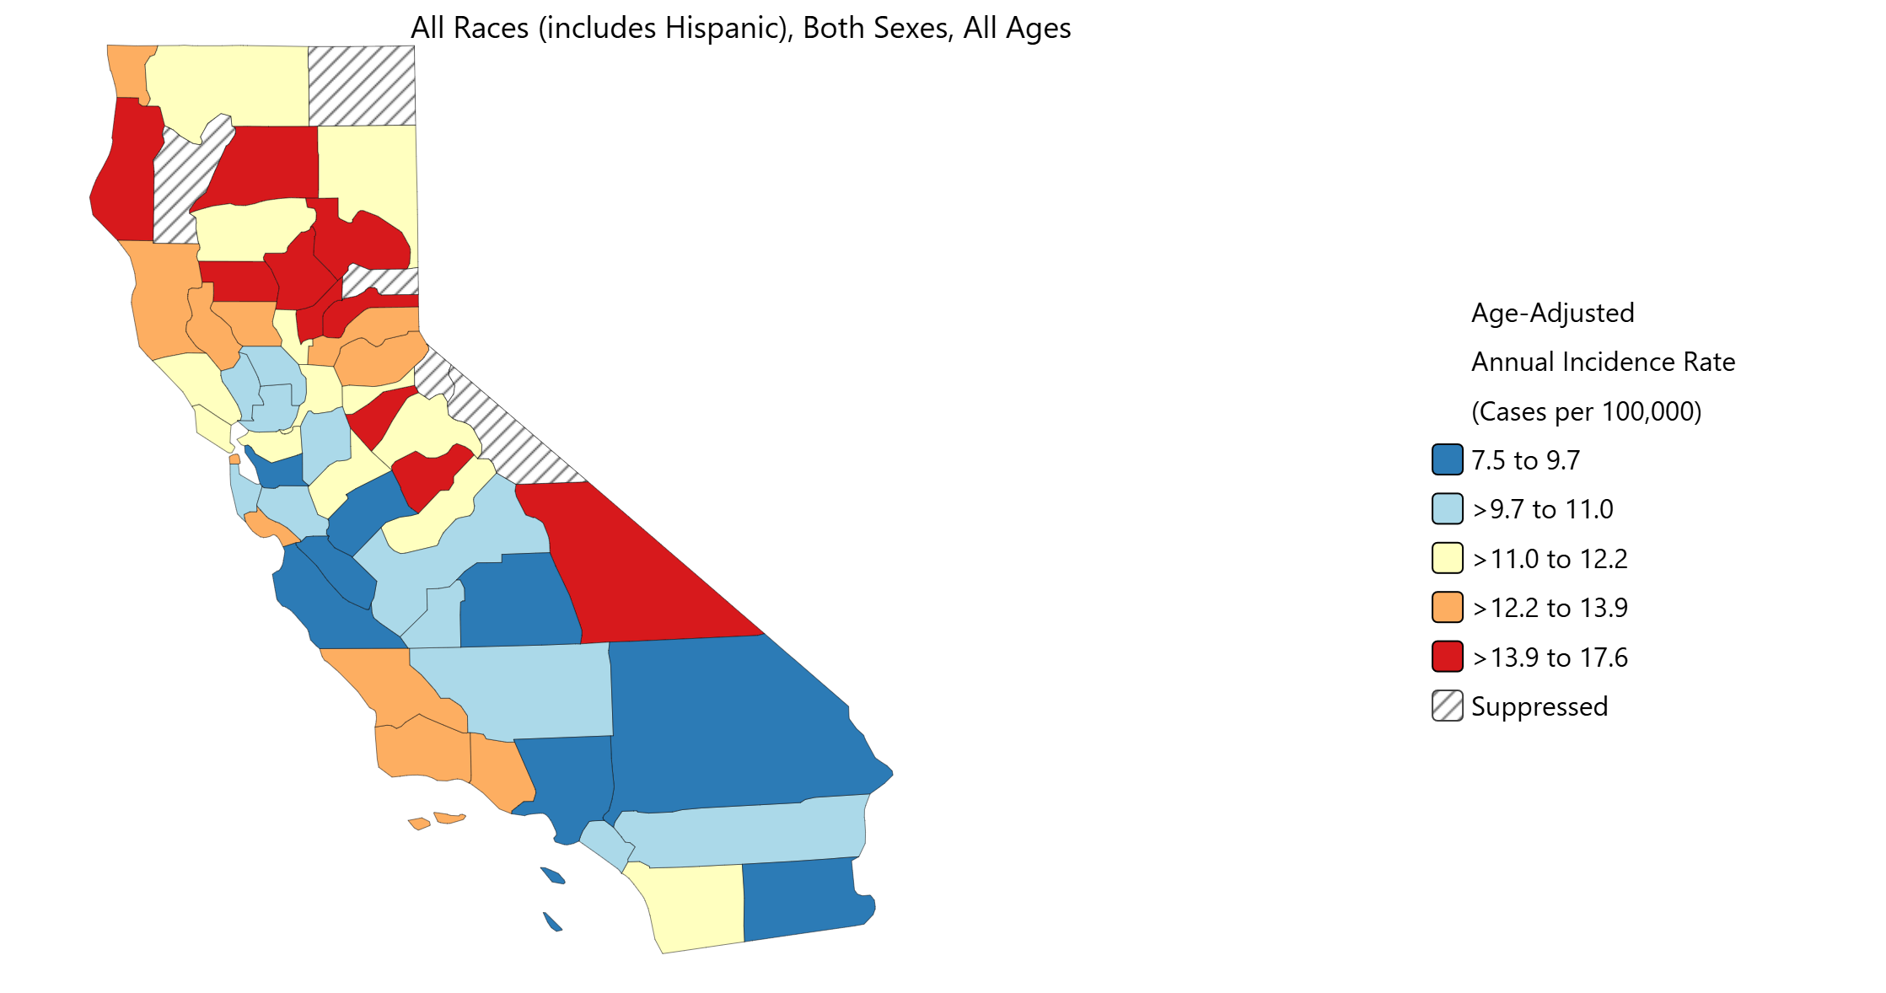
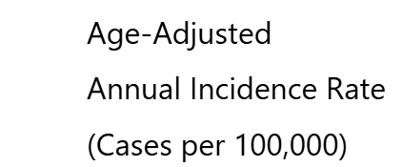
Oral and Pharyngeal Cancer – Overall Incidence & Disparities
The age-adjusted¹ incidence of oral and pharyngeal cancer is lower in Los Angeles County than in California or the US
LA County disparities, 2022 (per 100,000)
  Females (all races/all ages) 5.0
  Males (all races/all ages) 12.8
  Asian (both sexes/all ages) 7.0
  Black (both sexes/all ages) 8.3
  Latinx (both sexes/all ages) 6.2
  White (both sexes/all ages) 11.8
Age-adjusted¹ incidence of oral and pharyngeal cancer in California by county, 2018-2022
LA = 8.5 per 100,000
CA = 10.4 per 100,000
US = 12.1 per 100,000
¹ Age-adjustment is a statistical process applied to rates of disease, death, injuries or other health outcomes which allows communities with different age structures to be compared.
Cancers that occur in the oral cavity (mouth) and throat
Data Sources: National Cancer Institute, State Cancer Profiles, 2018-2022, https://statecancerprofiles.cancer.gov/; California Cancer Registry, California Department of Public Health, CAL*Explorer, 2022, https://explorer.ccrcal.org/
Accessed 04-25-2026

Slide 30
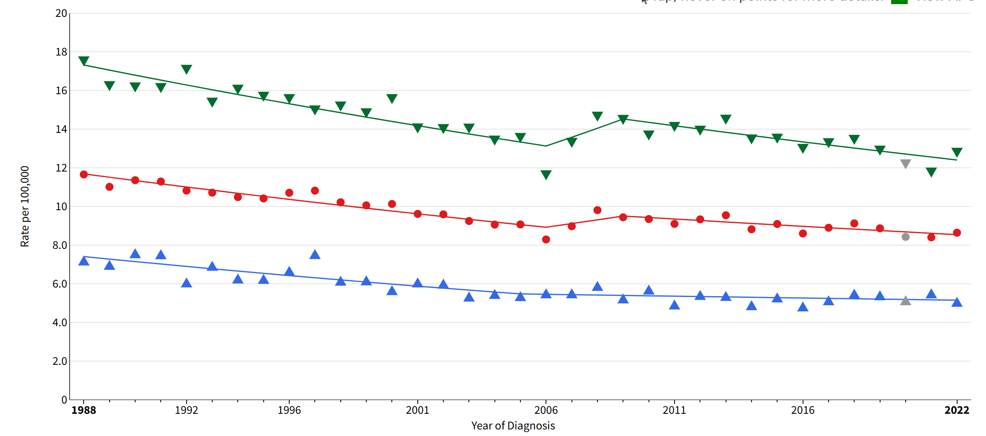
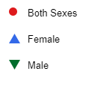
Oral and Pharyngeal Cancer – LA County Trends (Incidence)
Females
  Incidence has been falling since 1988
Males
  Incidence has been falling since 2009
Age-adjusted¹ incidence of oral and pharyngeal cancer
in LA County by sex and year (all races, all ages)
Sex | Annual Percent Change – LA County
 | Year Range | Estimate (%) | Direction
Female | 1988-2005 | -1.8 | Falling
 | 2005-2022 | -0.4 | Not Significant
Male | 1988-2006 | -1.5 | Falling
 | 2006-2009 | 3.4 | Not Significant
 | 2009-2022 | -1.2 | Falling
¹ Age-adjustment is a statistical process applied to rates of disease, death, injuries or other health outcomes which allows communities with different age structures to be compared.
Cancers that occur in the oral cavity (mouth) and throat
Data Source: California Cancer Registry, California Department of Public Health, CAL*Explorer, https://explorer.ccrcal.org/
Accessed 04-25-2026

Slide 31
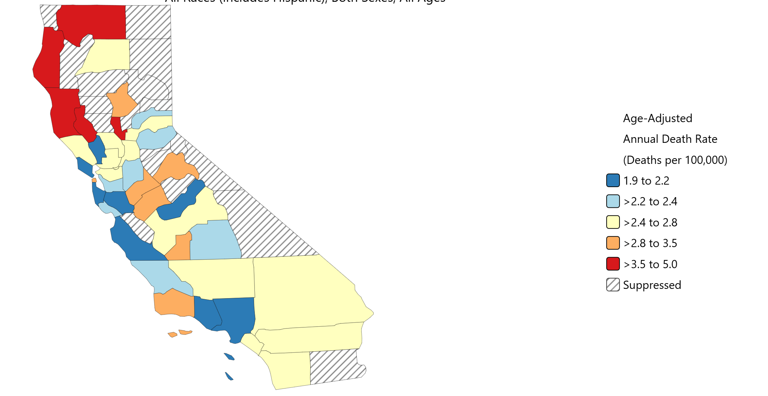
Oral and Pharyngeal Cancer – Mortality & Disparities
The age-adjusted¹ death rate from oral and pharyngeal cancer in Los Angeles County is similar to California and the US
LA County disparities, 2022 (per 100,000)
  Females (all races/all ages) 1.4
  Males (all races/all ages) 3.9
  Asian (both sexes/all ages) 2.4
  Black (both sexes/all ages) 2.3
  Latinx (both sexes/all ages) 1.5
  White (both sexes/all ages) 3.0
Age-adjusted¹ death rate from oral and pharyngeal cancer in California by county, 2019-2023
LA = 2.1 per 100,000
CA = 2.5 per 100,000
US = 2.7 per 100,000
¹ Age-adjustment is a statistical process applied to rates of disease, death, injuries or other health outcomes which allows communities with different age structures to be compared.
Cancers that occur in the oral cavity (mouth) and throat
Data Sources: National Cancer Institute, State Cancer Profiles, 2019-2023, https://statecancerprofiles.cancer.gov/; California Cancer Registry, California Department of Public Health, CAL*Explorer, 2022, https://explorer.ccrcal.org/
Accessed 04-25-2026

Slide 32
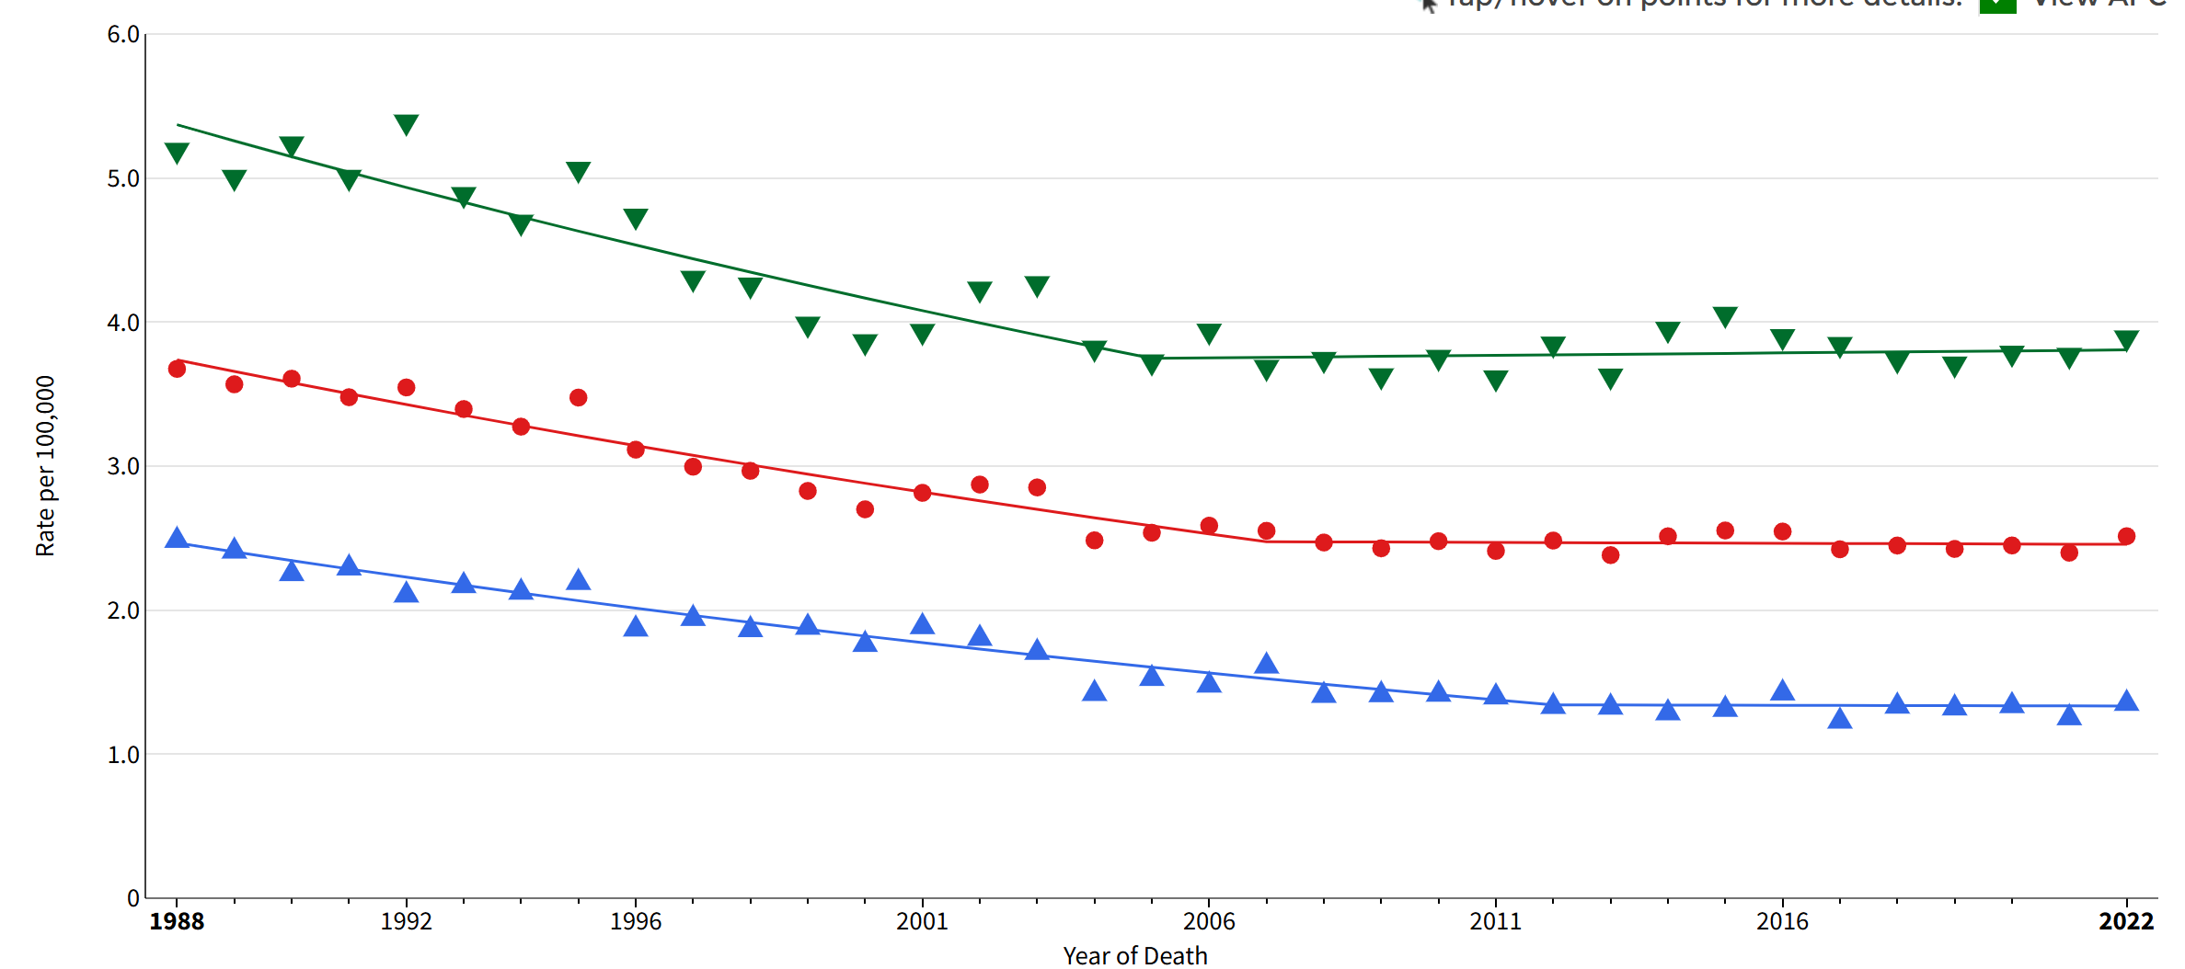
Oral and Pharyngeal Cancer – LA County Trends (Mortality)
Currently, death rates are stable for both females and males
Age-adjusted¹ death rates from oral and pharyngeal cancer
in LA County by sex and year (all races, all ages)
Sex | Annual Percent Change – LA County
 | Year Range | Estimate (%) | Direction
Female | 1988-2012 | -2.5 | Falling
 | 2012-2022 | -0.1 | Not Significant
Male | 1988-2005 | -2.1 | Falling
 | 2005-2022 | -0.1 | Not Significant
¹ Age-adjustment is a statistical process applied to rates of disease, death, injuries or other health outcomes which allows communities with different age structures to be compared.
Cancers that occur in the oral cavity (mouth) and throat
Data Source: California Cancer Registry, California Department of Public Health, CAL*Explorer, https://explorer.ccrcal.org/
Accessed 04-25-2026

Slide 33

Use of the Dental Care Delivery System
Children 1-11 Years
Adults 18+ Years
Adults 18+ Years with Diabetes
Medicaid (Medi-Cal) Enrollees

Slide 34
USE OF THE DENTAL CARE DELIVERY SYSTEM
DATA-AT-A-GLANCE
Indicator/Population Group | LA County | California | United States
Dental visit in past year (self-report) | Percentage (Year) | Percentage (Year) | Percentage (Year)
Children 1-4 years | 70% (2023-2024) | 63% (2023-2024) | 65% (2023-2024)^
Children 5-11 years | 93% (2023-2024) | 94% (2023-2024) | 91% (2023-2024)^
Adolescents 12-17 years* | 92% (2023-2024) | 91% (2023-2024) | 90% (2023-2024)
Adults 18+ years | 68% (2023-2024) | 70% (2023-2024) | 66% (2022)
Adults 18+ years with diabetes | 63% (2023-2024) | 65% (2023-2024) | 60% (2022)
Dental visit during pregnancy (self-report)
Pregnant women | 48% (2022-2023) | 48% (2022-2023) | Not Available
Dental visit during calendar/fiscal year (claims data)
Medicaid enrollees 0-20 years | 51% (CY2023) | 49% (CY2023) | 47% (FY2024)
Medicaid enrollees 21+ years | 26% (CY2023) | 24% (CY2023) | Not Available
Used free community or public dental programs
Children 1-4 years | 17% (2023-2024) | 15% (2023-2024) | Not Available
Children 5-11 years | 24% (2023-2024) | 19% (2023-2024) | Not Available
* LA County and California data was obtained from the adolescent while US data was obtained from the parent
^ US data is for children 1-5 years and children 6-11 years

Slide 35
Dental Visit in Past Year Among Children – Overall Prevalence
The percentage of children with a dental visit in the past year is similar for LA County, California and the US
Most parents report that their child aged 5-11 years had a dental visit in the past year
Percentage of children with a dental visit in past year
¹
¹ US data is for children aged 1-5 and 6-11 years
Data Sources: California Health Interview Survey (CHIS), 2023-2024 pooled, https://healthpolicy.ucla.edu/our-work/askchis; National Survey of Children’s Health, 2023-2024, https://www.childhealthdata.org/
CHIS question: asked of all children 3-11 years of age and children under 3 years of age with teeth
Accessed 04-26-2026

Slide 36
Dental Visit in Past Year Among Children – California¹ Disparities
Percentage of California¹ children 1-11 years with a dental visit by income, race/ethnicity, and language spoken at home, 2023-2024
In California, the percentage of children with a dental visit in the past year does not vary by income, race/ethnicity, or language spoken at home
FPL = Federal poverty level
¹ Because of small sample sizes, LA County data is not available
Data Source: California Health Interview Survey (CHIS), 2023-2024 pooled, https://healthpolicy.ucla.edu/our-work/askchis
CHIS question: asked of all children 3-11 years of age and children under 3 years of age with teeth
Accessed 04-26-2026

Slide 37
Dental Visit in Past Year Among Children – LA County Trends
Percentage of LA County children with a
dental visit in the past year by age and survey year
The percentage of children with a dental visit in the past year has not changed significantly since 2013
Data Source: California Health Interview Survey (CHIS), 2013-2024, https://healthpolicy.ucla.edu/our-work/askchis
CHIS question: asked of all children 3-11 years of age and children under 3 years of age with teeth
Accessed 04-26-2026

Slide 38
Dental Visit in Past Year Among Adolescents – Overall Prevalence
Almost all adolescents in LA County and California report a dental visit in the last year
  IMPORTANT NOTE: US data is from the National Survey of Children’s Health which asks parents about last dental visit. LA County and California data is from the California Health Interview Survey which asks the adolescent about time since last dental visit.
Percentage of adolescents aged 12-17 years with a
dental visit in the past year, 2023-2024
¹
¹ US data was obtained from a parent questionnaire while LAC and CA surveyed adolescents
Data Sources: California Health Interview Survey (CHIS), 2023-2024 pooled, https://healthpolicy.ucla.edu/our-work/askchis; National Survey of Children’s Health, 2023-2024, https://www.childhealthdata.org/
CHIS question: asked of all adolescents 12-17 years
Accessed 04-26-2026

Slide 39
Dental Visit in Past Year Among Adolescents – California¹ Disparities
Percentage of California¹ adolescents 12-17 years with a dental visit by income, race/ethnicity, and language spoken at home, 2023-2024
In California, the percentage of adolescents with a dental visit in the past year does not vary by income, race/ethnicity, or language spoken at home
FPL = Federal poverty level
¹ Because of small sample sizes, LA County data is not available
Data Source: California Health Interview Survey (CHIS), 2023-2024 pooled, https://healthpolicy.ucla.edu/our-work/askchis
CHIS question: asked of all adolescents 12-17 years
Accessed 04-26-2026

Slide 40
Dental Visit in Past Year Among Adolescents – LA County Trends
Percentage of LA County adolescents 12-17 years with a
dental visit in the past year by survey year
In 2009, 88% of adolescents reported a dental visit in the last year compared to 96% in 2019
In 2021, the percentage reporting a dental visit in the last year dropped to 85% - this may have been due to issues associated with accessing dental care during COVID-19
Since 2021, the percentage reporting a dental visit in the last year has steadily increased
Data Source: California Health Interview Survey (CHIS), 2009-2024, https://healthpolicy.ucla.edu/our-work/askchis
CHIS question: asked of all adolescents 12-17 years
Accessed 04-26-2026

Slide 41
Dental Visit in Past Year Among Adults – Overall Prevalence
The percentage of LA County adults with a dental visit in the last year is similar to the percentage of adults in California and the US
Among LA County adults, the primary reason for their last dental visit was…
  Routine checkup or cleaning: 70%
  Specific problem: 16%
  Both: 14%
NOTE: As of May 2026, the CDC has released 2024 BRFSS data, but has not published precomputed prevalence estimates for time since last dental visit
Percentage of adults 18+ years with a dental visit in past year
Data Sources: California Health Interview Survey (CHIS), 2023-2024 pooled, https://healthpolicy.ucla.edu/our-work/askchis; Behavioral Risk Factor Surveillance System (BRFSS), 2022, https://www.cdc.gov/brfss/brfssprevalence/
Accessed 04-26-2026

Slide 42
Dental Visit in Past Year Among Adults – California¹ Disparities
Percentage of California¹ adults aged 18+ years with a dental visit by sex, income, race/ethnicity, education, and age, 2023-2024
Lower income adults are significantly less likely to have an annual dental visit compared to higher income adults
~
Asian, Black/African American and Latino/Latinx adults are significantly less likely to have an annual dental visit compared to Whites
*
+
Adults with less than a high school education are significantly less likely to have an annual dental visit compared to adults with a college degree
^
Adults less than 54 years are significantly less likely to have an annual dental visit compared to adults 65+ years
^
~Significantly lower than females
*Significantly lower prevalence than > 200% FPL
+Significantly lower prevalence than White adults
#Significantly lower prevalence than college graduates
^Significantly lower prevalence than adults 65+ years
¹ Because of small sample sizes, LA County data is not available
Data Source: California Health Interview Survey (CHIS), 2023-2024 pooled, https://healthpolicy.ucla.edu/our-work/askchis
Accessed 04-26-2026

Slide 43
Dental Visit in Past Year Among Adults – LA County Trends
Percentage of LA County adults aged 18+ years with a
dental visit in the past year by survey year
Approximately 2 out of 3 adults in LA County had a dental visit in the past year
From 2018 to 2021, there was a steady decline in the percentage of adults with a dental visit in the past year. This may have been the result of limited access to dental care during COVID.
Post-COVID, the percentage of LA County adults with a dental visit has increased
Data Source: California Health Interview Survey (CHIS), 2013-2024, https://healthpolicy.ucla.edu/our-work/askchis
Accessed 04-26-2026

Slide 44
Dental Visit in Past Year Among Adults with Diabetes
The percentage of adults with diabetes aged 18+ years with a dental visit in the past year is similar for LA County, California and the US
Information on disparities is not presented because estimates are statistically unstable
NOTE: As of May 2026, the CDC has released 2024 BRFSS data, but has not published precomputed prevalence estimates for time since last dental visit among adults with diabetes
Percentage of adults with diagnosed diabetes aged 18+ years
with a dental visit in the past year
Data Sources: California Health Interview Survey, 2023-2024 pooled, https://healthpolicy.ucla.edu/our-work/askchis; Behavioral Risk Factor Surveillance System, 2022, https://www.cdc.gov/cdi/index.html
Accessed 04-26-2026

Slide 45
Dental Visit in Past Year Among Adults with Diabetes – LA County Trends
About 2-of-3 LA County adults with diabetes report having a dental visit in the past year
Percentage of LA County adults with diagnosed diabetes aged 18+ years with a dental visit in the past year by survey year
Data Source: California Health Interview Survey, 2013-2024, https://healthpolicy.ucla.edu/our-work/askchis
Accessed 04-26-2026

Slide 46
Dental Visit Among Pregnant Women - Prevalence
The percentage of women with a dental visit during pregnancy is the same for LA County and California
  NOTE: Data for the US is not available
Percentage of women with a recent live birth that visited the dentist during their pregnancy, 2022-2023
Data Source: California Maternal and Infant Health Assessment, 2022-2023. Analysis obtained from California Department of Public Health, Office of Oral Health.

Slide 47
Dental Visit Among Pregnant Women – LA County Disparities
Lower income women are significantly less likely to have a dental visit during pregnancy compared to higher income women
Percentage of pregnant women in LA County with a dental visit by income, race/ethnicity, education, and insurance, 2022-2023
*
*
Black/African American and Latina/Latinx women are significantly less likely to have a dental visit during pregnancy compared to White women
Women with less than a college degree are significantly less likely to have a dental visit during pregnancy compared to women with a college degree
Women with Medi-Cal are less likely to have a dental visit during pregnancy compared to those with private insurance but the difference is not statistically significant
*Significantly lower prevalence than > 200% FPL
+Significantly lower prevalence than White women
#Significantly lower prevalence than college graduates
FPL=Federal poverty level
Data Source: California Maternal and Infant Health Assessment, 2022-2023. Analysis obtained from California Department of Public Health, Office of Oral Health.

Slide 48
Dental Visit Among Pregnant Women – LA County Trends
The percentage of LA County women with a dental visit during their pregnancy increased in 2022-2023
Percentage of LA County women with a recent live birth that visited the dentist during their pregnancy
Data Source: California Maternal and Infant Health Assessment. Analysis obtained from California Department of Public Health, Office of Oral Health.

Slide 49
Dental Visit Among Pregnant Women – Barriers to Care
Reasons why LA County women with a recent live birth did not visit a dentist during pregnancy, 2022-2023
58%
34%
Didn’t need to go
Cost
38%
24%
Too busy
No dental insurance
40%
Did not think it was safe
to go to dentist during pregnancy
Data Source: California Maternal and Infant Health Assessment, 2022-2023. Analysis obtained from California Department of Public Health, Office of Oral Health.
NOTE: Women could select multiple reasons, therefore, the total exceeds 100%

Slide 50
Dental Visit in Year Among Medicaid Children - Prevalence
The percentage of children aged 0-20 years enrolled in Medicaid with a dental visit in the calendar/fiscal year is similar for LA County, California, and the US
Percentage of Medicaid (Medi-Cal) enrollees aged 0-20 years with a dental visit in the calendar/fiscal year*
*Denominator=Number enrolled for 90 continuous days
FY=Fiscal Year, CY=Calendar Year
Data Sources: California Health and Human Services, Dental Utilization Measures and Sealant Data by County and Age Calendar Year 2013 to 2023, https://data.chhs.ca.gov/dataset/test-dhcs-utilization-measures-and-sealant-data-by-county-calendar-year-2013-to-2021; Centers for Medicare and Medicaid Services, EPSDT/CMS-416, FY2024, https://www.medicaid.gov/medicaid/benefits/early-and-periodic-screening-diagnostic-and-treatment/epsdt-data
Accessed 04-26-2026

Slide 51
Dental Visit in Year Among Medicaid Enrollees - Prevalence
The percentage of Medi-Cal enrollees with a dental visit is highest among children 6-9 years of age
For Medi-Cal adults, fewer than 3 out of 10 had a dental visit in 2023
Percentage of LA County Medicaid (Medi-Cal) enrollees
with a dental visit in calendar year 2023 by age
Data Source: California Health and Human Services, Dental Utilization Measures and Sealant Data by County and Age Calendar Year 2013 to 2023, https://data.chhs.ca.gov/dataset/test-dhcs-utilization-measures-and-sealant-data-by-county-calendar-year-2013-to-2021
Accessed 04-26-2026

Slide 52
Dental Visit Among Medicaid Enrollees – LA County Trends
From 2013 to 2019, the percentage of Medi-Cal enrollees with a dental visit increased for all age groups but decreased in 2020 due to COVID related dental office closures
From 2020 to 2023, there was an increase in the percentage of Medi-Cal enrollees with a dental visit
Percentage of LA County Medicaid (Medi-Cal) enrollees
with a dental visit by age and year, 2013, 2019, 2020, 2023
*Denominator=Number enrolled for 90 continuous days
Data Source: California Health and Human Services, Dental Utilization Measures and Sealant Data by County and Age Calendar Year 2013 to 2023, https://data.chhs.ca.gov/dataset/test-dhcs-utilization-measures-and-sealant-data-by-county-calendar-year-2013-to-2021
Accessed 04-26-2026

Slide 53
Use of Free/Public Clinics Among Children – Overall Prevalence
The percentage of children that received dental care at a free community or public dental clinic was slightly higher in LA County compared to California
Data for the US is not available
Percentage of children that received services at a free community or public dental clinic, 2023-2024
Data Source: California Health Interview Survey (CHIS), 2023-2024 pooled, https://healthpolicy.ucla.edu/our-work/askchis
CHIS question: Asked of children older than two or younger children with teeth
Accessed 04-26-2026

Slide 54
Use of Free/Public Clinics Among Children – California¹ Disparities
Percentage of California¹ children 1-11 years that used a free
or public dental clinic by selected characteristics, 2023-2024
Lower income children are significantly more likely to use free/public dental clinics compared to their higher income peers
*
*
Latinx children are more likely to use free/public dental clinics compared to children from other racial/ethnic groups
Children from households where Spanish is the primary language are more likely to use free/public dental clinics compared to children from English speaking households
+
+
#
*Significantly higher prevalence than > 300% FPL
+Significantly higher prevalence than White children
#Significantly higher prevalence than English only
FPL = Federal poverty level
¹ Because of small sample sizes, LA County data is not available
Data Source: California Health Interview Survey (CHIS), 2023-2024 pooled, https://healthpolicy.ucla.edu/our-work/askchis
CHIS question: Asked of children older than two or younger children with teeth
Accessed 04-26-2026

Slide 55
Use of Free/Public Clinics Among Children – LA County Trends
Percentage of LA County children 1-11 years that used a free
or public dental clinic by survey year
The percentage of children that used a free community or public dental clinic doubled between 2017 and 2019, fell in 2020, then increased to pre-COVID levels by 2023
Data Source: California Health Interview Survey (CHIS), 2017-2024, https://healthpolicy.ucla.edu/our-work/askchis
CHIS question: Asked of children older than two or younger children with teeth
Accessed 04-26-2026

Slide 56

Missed School Because of Dental Problems
Children 5-11 Years
Adolescents 12-17 Years

Slide 57
Missed School Days Because of Dental Problems*
DATA-AT-A-GLANCE
Indicator/Population Group | LA County | California | United States
Missed school because of dental problems* | Percentage (Year) | Percentage (Year) | Percentage (Year)
Children 5-11 years | 6% (2023-2024) | 7% (2023-2024) | Not Available
Adolescents 12-17 years | 14% (2023-2024) | 12% (2023-2024) | Not Available
* Does not include dental visits for cleanings or check-ups

Slide 58
Missed School Because of Dental Problems – Overall Prevalence
The percentage of children that missed school because of dental problems is the same for LA County and California
Data for the US is not available
Information on disparities and LA County trends are not presented because estimates are statistically unstable
IMPORTANT NOTE: Parents reported missed school days for children 5-11 while adolescents reported their own missed school days
Percentage of children & adolescents that missed school because of dental problems, 2023-2024
Data Source: California Health Interview Survey (CHIS), 2023-2024 pooled, https://healthpolicy.ucla.edu/our-work/askchis
CHIS question: Asked of children & adolescents aged 5 years and older who attend school
Accessed 04-26-2026

Slide 59
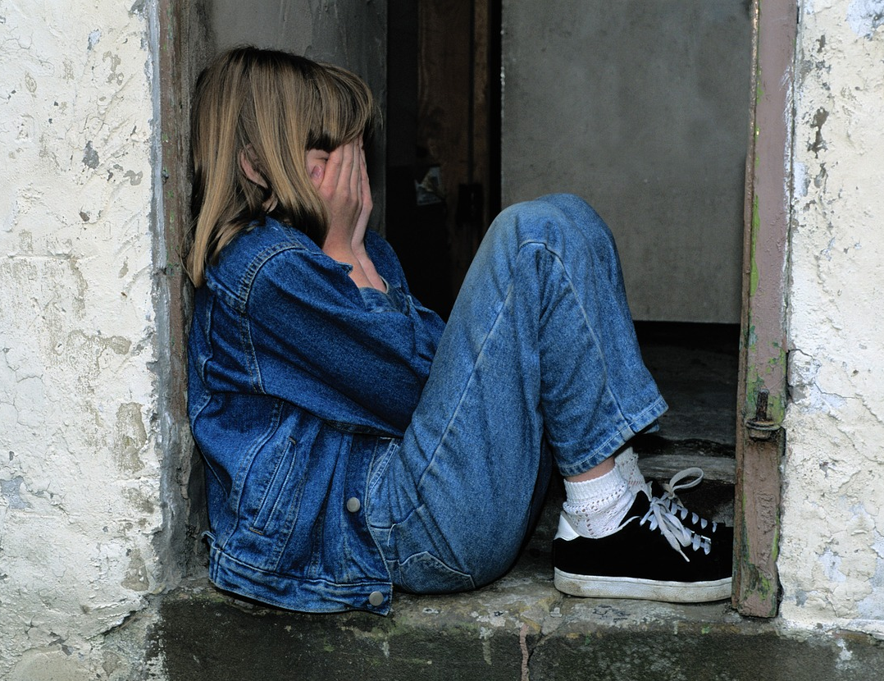
Problems Accessing Dental Care
Children 1-11 Years

Slide 60
Problems Accessing Dental Care
DATA-AT-A-GLANCE
Indicator/Population Group | LA County | California | United States
Could not afford needed dental care | Percentage (Year) | Percentage (Year) | Percentage (Year)
Children 1-4 years | 5% (2023-2024) | 4% (2023-2024) | Not Available
Children 5-11 years | 9% (2023-2024) | 9% (2023-2024) | Not Available

Slide 61
Could Not Afford Needed Dental Care – Overall Prevalence
The California Health Interview Survey (CHIS) asked parents if there was a time when their child needed dental care but did not get it because they could not afford it
The percentage of parents reporting problems accessing dental care because of cost is similar for LA County and California
Data for the US is not available
Percentage of children not getting needed care
because of cost, 2023-2024
Data Source: California Health Interview Survey (CHIS), 2023-2024 pooled, https://healthpolicy.ucla.edu/our-work/askchis
CHIS question: asked of children older than 2 or younger than 2 with teeth
Accessed 04-26-2026

Slide 62
Could Not Afford Dental Care – California¹ Disparities
Percentage of California¹ children 1-11 years that did not receive needed dental care because of cost, 2023-2024
Children from lower-income families are more likely to report problems accessing dental care compared to children from families with an income > 300% FPL
*
*
Latinx children are more likely to have problems accessing dental care because of cost compared to White children
+
*Significantly higher prevalence than > 300% FPL
+Significantly higher prevalence than White children
FPL = Federal poverty level
¹ Because of small sample sizes, LA County data is not available
Data Sources: California Health Interview Survey (CHIS), 2023-2024 pooled, https://healthpolicy.ucla.edu/our-work/askchis
CHIS question: asked of children older than 2 or younger than 2 with teeth
Accessed 04-26-2026

Slide 63
Could Not Afford Dental Care – LA County Trends
Percentage of LA County children 1-11 years that did not receive needed dental care because of cost by survey year
This question was not asked prior to 2018
Estimates for 2018 are statistically unstable
* Estimates for 2018 are statistically unstable
Data Source: California Health Interview Survey (CHIS), 2018-2024, https://healthpolicy.ucla.edu/our-work/askchis
CHIS question: Asked of children older than two or younger children with teeth
Accessed 04-26-2026

Slide 64

Dental Insurance
Coverage
Children 1-11 Years
Adults 18+ Years

Slide 65
DENTAL INSURANCE COVERAGE
DATA-AT-A-GLANCE
Age/Indicator | LA County 2013 | LA County 2023-2024 | California 2023-2024 | United States
1-11 Years
Has dental insurance coverage | 88% | 89% | 92% | Not Available
Parents pays for any/all dental insurance* | Not Available | 44% | 46% | Not Available
18+ Years
Has dental insurance coverage | 52% | 70% | 73% | Not Available
* Limited to children with dental insurance

Slide 66
Dental Insurance Among Children 1-11 Years – Overall Prevalence
Percentage of children aged 1-11 years with
dental insurance coverage, 2023-2024
Almost all children in California and LA County have dental insurance
  Comparable data for the United States is not available
In LA County, there are no disparities in terms of dental insurance coverage
  The percentage of children with dental insurance coverage does not vary by socioeconomic status, race/ethnicity, or language spoken at home
Data Source: California Health Interview Survey, 2023-2024 pooled, https://healthpolicy.ucla.edu/our-work/askchis
CHIS question: asked of all children 3-11 years of age and children under 3 years of age with teeth
Accessed 04-26-2026

Slide 67
Dental Insurance Among Children 1-11 Years – LA County Trends
Percentage of LA County children aged 1-11 years
with dental insurance coverage
Since 2013, the percentage of LA County children with dental insurance coverage has remained stable
44%
The percentage of parents that report paying any or all of the premium or cost for their child’s dental insurance
Data Source: California Health Interview Survey (CHIS), 2013-2024, https://healthpolicy.ucla.edu/our-work/askchis
CHIS question: asked of all children 3-11 years of age and children under 3 years of age with teeth
Accessed 04-26-2026

Slide 68
Dental Insurance Among Adults 18+ Years – Overall Prevalence
Percentage of adults 18+ years with dental insurance,
2023-2024
About 7-of-10 adults in California and LA County have dental insurance
Comparable data for the United States is not available
Data Source: California Health Interview Survey, 2023-2024 pooled, https://healthpolicy.ucla.edu/our-work/askchis
Accessed 04-26-2026

Slide 69
Dental Insurance Among Adults 18+ Years – LA County Disparities
Percentage of LA County adults aged 18+ years with dental insurance coverage, 2023-2024
Lower income adults are significantly less likely to have dental insurance compared to higher income adults
*
+
Latinx adults are significantly less likely to have dental insurance compared to Black/African American and White adults
‡
Adults with less than a college degree are significantly less likely to have dental insurance compared to adults with a college degree
#
#
Adults that speak non-English languages at home are significantly less likely to have dental insurance compared to adults that speak only English
~
Older adults are significantly less likely to have dental insurance compared to younger adults aged 18-64 years
*Significantly lower than > 200% FPL
+Significantly lower than Black adults
‡Significantly lower than White adults
#Significantly lower than college graduates
^Significantly lower than adults that speak only English
~Significantly lower than adults 18-64 years
Data Source: California Health Interview Survey, 2023-2024 pooled, https://healthpolicy.ucla.edu/our-work/askchis
Accessed 04-26-2026

Slide 70
Dental Insurance Among Adults 18+ Years – LA County Trends
Percentage of LA County adults aged 18+ years with
dental insurance coverage, 2013-2024
Since 2013, the percentage of LA County adults with dental insurance has steadily increased
Data Source: California Health Interview Survey, 2013-2024, https://healthpolicy.ucla.edu/our-work/askchis
Accessed 04-26-2026

Slide 71
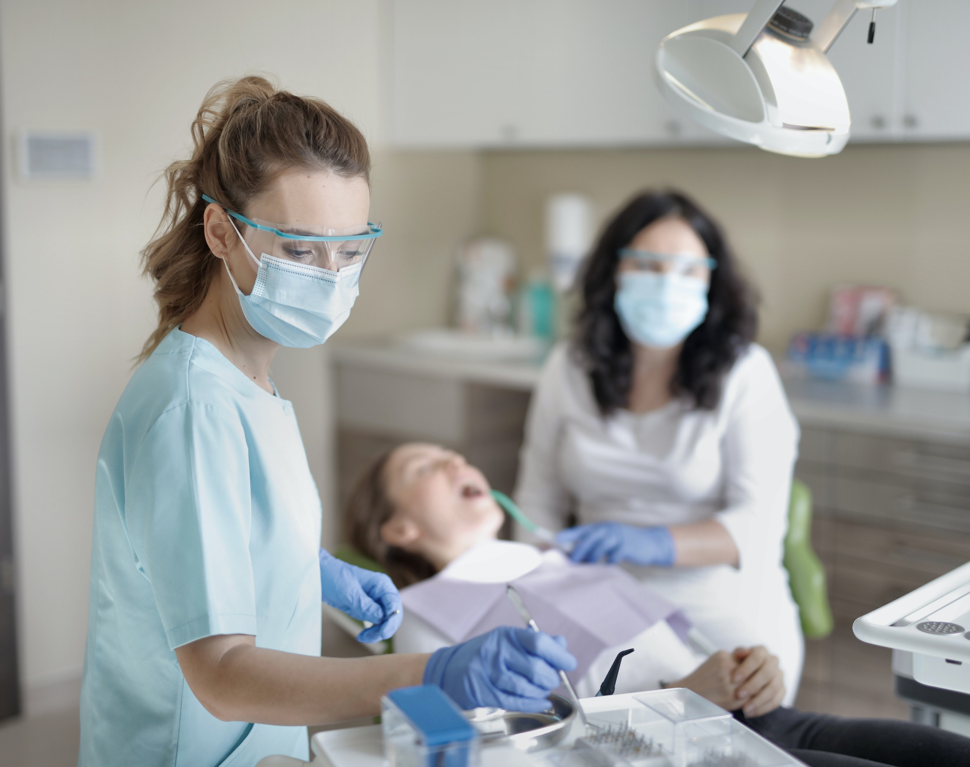
Preventive Services Among Medicaid Enrollees
Any Preventive Service
Dental Sealants

Slide 72
PREVENTIVE SERVICES AMONG MEDICAID ENROLLEES
DATA-AT-A-GLANCE
Indicator/Age | LA County 2013 | LA County CY2019 | LA County CY2023 | California CY2023 | United States FY2024
Any preventive service
Children 0-20 years | 42% | 47% | 48% | 46% | 44%
Adults 21+ years | 2% | 13% | 15% | 15% | Not Available
Dental sealants permanent molars
Children 6-9 years | 20% | 22% | 19% | 17% | 15%
Children 10-14 years | 11% | 13% | 13% | 10% | 12%

Slide 73
Any Preventive Service Among Medicaid Children - Prevalence
The percentage of Medicaid enrolled children aged 0-20 years with a preventive dental service in the calendar/fiscal year is slightly higher in LA County compared to California and the US
Percentage of Medicaid (Medi-Cal) enrollees aged 0-20 years with any preventive service in the calendar/fiscal year*
*Denominator=Number enrolled for 90 continuous days
FY=Fiscal Year, CY=Calendar Year
Data Sources: California Health and Human Services, Dental Utilization Measures and Sealant Data by County and Age Calendar Year 2013 to 2023, https://data.chhs.ca.gov/dataset/test-dhcs-utilization-measures-and-sealant-data-by-county-calendar-year-2013-to-2021 ; Centers for Medicare and Medicaid Services, EPSDT/CMS-416, FY2024, https://www.medicaid.gov/medicaid/benefits/early-and-periodic-screening-diagnostic-and-treatment/epsdt-data
Accessed 04-26-2026

Slide 74
Any Preventive Service Among Medicaid Enrollees - Prevalence
The percentage of Medi-Cal enrollees with a preventive dental service is highest among children 6-9 years of age
For Medi-Cal adults, fewer than 1 out of 6 had a preventive dental service in 2023
Percentage of LA County Medicaid (Medi-Cal) enrollees
with a preventive dental service in calendar year 2023 by age*
*Denominator=Number enrolled for 90 continuous days
Data Source: California Health and Human Services, Dental Utilization Measures and Sealant Data by County and Age Calendar Year 2013 to 2023, https://data.chhs.ca.gov/dataset/test-dhcs-utilization-measures-and-sealant-data-by-county-calendar-year-2013-to-2021
Accessed 04-26-2026

Slide 75
Any Preventive Service Among Medicaid Enrollees – LA County Trends
Between 2013 and 2019, the percentage of Medi-Cal enrollees with a preventive dental service increased for all age groups but declined in CY2020 due to COVID-19
In CY2023, the percentage of Medi-Cal enrollees with a preventive dental service increased for all age groups
Percentage of LA County Medi-Cal enrollees with a preventive dental service by age and year, 2013, 2019, 2020 & 2023*
*Denominator=Number enrolled for 90 continuous days
Data Source: California Health and Human Services, Dental Utilization Measures and Sealant Data by County and Age Calendar Year 2013 to 2023, https://data.chhs.ca.gov/dataset/test-dhcs-utilization-measures-and-sealant-data-by-county-calendar-year-2013-to-2021
Accessed 04-26-2026

Slide 76
Dental Sealant Placement Among Medicaid Children - Prevalence
The percentage of Medicaid enrolled children aged 6-9 years that received a sealant on a permanent molar was higher in LA County when compared to California and the US
The percentage of Medicaid enrolled children aged 10-14 years that received a sealant on a permanent molar in LA County was similar to California and the US
Percentage of Medicaid (Medi-Cal) enrollees aged 6-14 years receiving a dental sealant in the calendar/fiscal year by age*
*Denominator=Number enrolled for 90 continuous days
FY=Fiscal Year, CY=Calendar Year
Data Sources: California Health and Human Services, Dental Utilization Measures and Sealant Data by County and Age Calendar Year 2013 to 2023, https://data.chhs.ca.gov/dataset/test-dhcs-utilization-measures-and-sealant-data-by-county-calendar-year-2013-to-2021 ; Centers for Medicare and Medicaid Services, EPSDT/CMS-416, FY2024, https://www.medicaid.gov/medicaid/benefits/early-and-periodic-screening-diagnostic-and-treatment/epsdt-data
Accessed 04-26-2026

Slide 77
Dental Sealants Among Medicaid Enrollees – LA County Trends
The percentage of Medi-Cal enrollees aged 6-9 and 10-14 years that received a dental sealant on a permanent molar was similar in 2013 and 2019, decreased in 2020, then increased in 2021 and 2022
Percentage of LA County Medi-Cal enrollees that received a dental sealant by age and calendar year, 2013, 2019-2023*
*Denominator=Number enrolled for 90 continuous days
Data Source: California Health and Human Services, Dental Utilization Measures and Sealant Data by County and Age Calendar Year 2013 to 2023, https://data.chhs.ca.gov/dataset/test-dhcs-utilization-measures-and-sealant-data-by-county-calendar-year-2013-to-2021
Accessed 04-26-2026

Slide 78

Community Water Fluoridation

Slide 79
Community Water Fluoridation
Percentage of population on a community water
system receiving fluoridated water
The percentage of the population receiving fluoridated water is higher in LA County when compared to the California average
NOTE: The LA County fluoridation data is the percentage of the population served by water systems with 10,000+ connections that receive the recommended level of fluoride
Data Sources: CDC, 2022 Fluoridation Statistics, https://www.cdc.gov/fluoridation/php/statistics/2022-water-fluoridation-statistics.html; Los Angeles County Department of Public Health Oral Health Program, Fluoridation Map, 2021
Accessed 04-26-2026

Slide 80
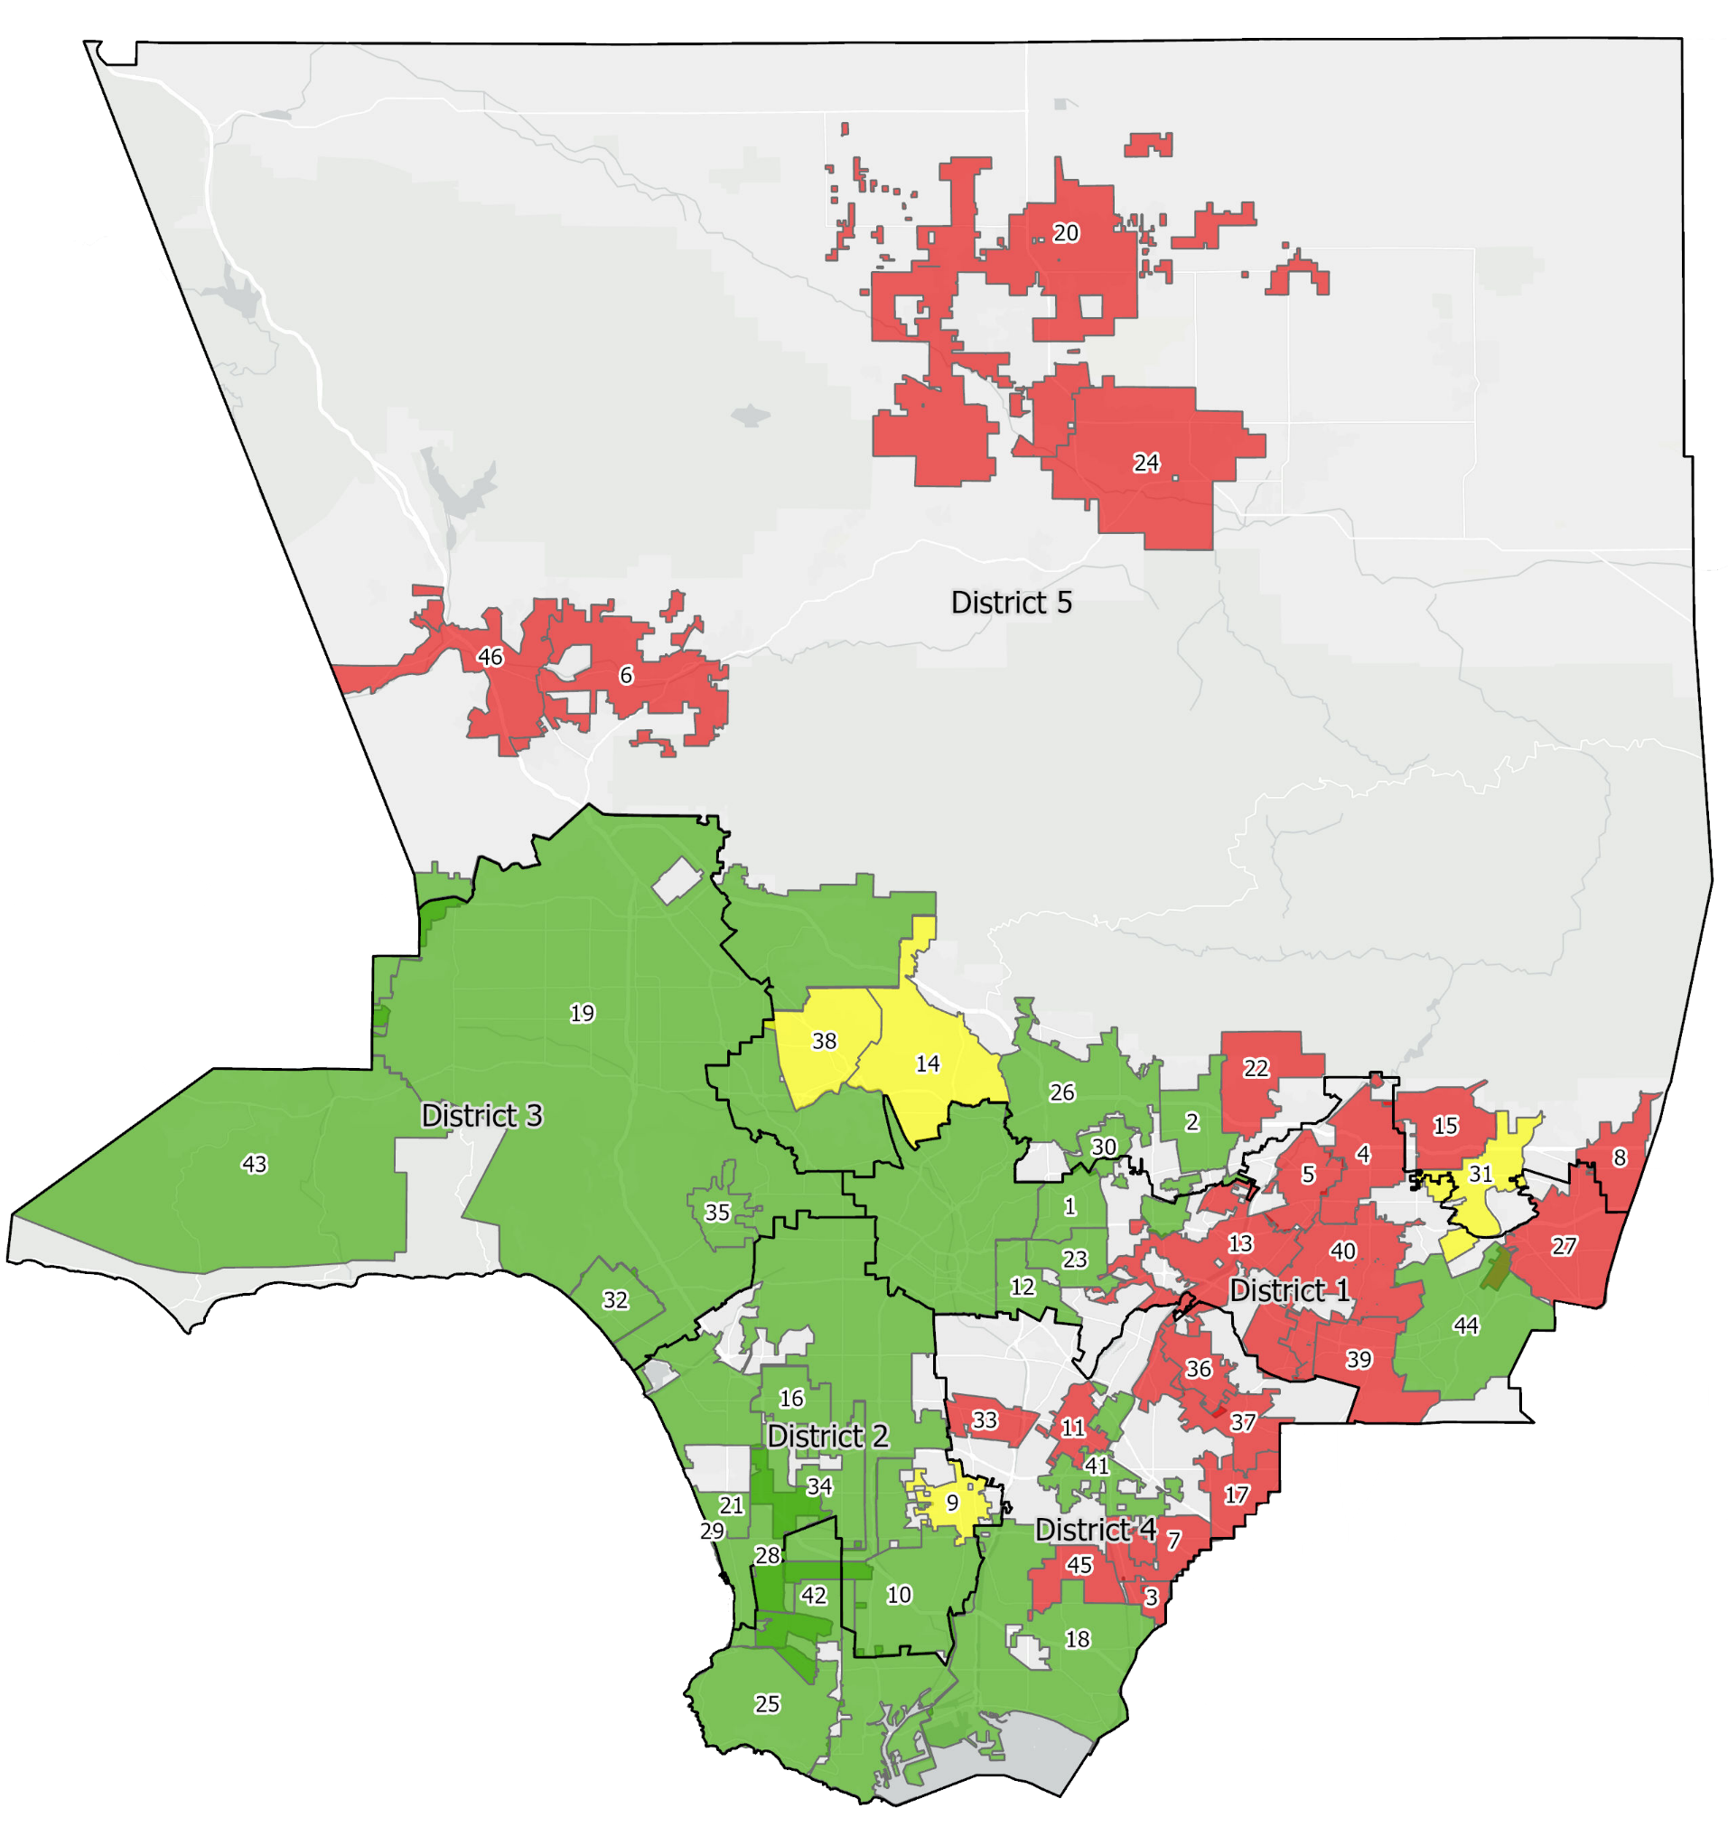
Fluoridation Status of Water Systems With 10,000+ Connections, 2021
Map Number | Water System Name | Map Number | Water System Name
1 | CITY OF ALHAMBRA | 24 | PALMDALE WATER DIST.
2 | CITY OF ARCADIA | 25 | CALIFORNIA WATER SERVICE CO. - PALOS VER
3 | GSWC - ARTESIA | 26 | PASADENA-CITY, WATER DEPT.
4 | AZUSA LIGHT AND WATER | 27 | POMONA - CITY, WATER DEPT.
5 | VALLEY COUNTY WATER DIST. | 28 | CALIFORNIA WATER SERVICE CO. - HERM/REDO
6 | SANTA CLARITA VALLEY W.A.-SANTA CLARITA | 29 | CALIFORNIA WATER SERVICE CO. - HERM/REDO
7 | CERRITOS - CITY, WATER DEPT. | 30 | CAL/AM WATER COMPANY - SAN MARINO
8 | GSWC - CLAREMONT | 31 | GSWC-SAN DIMAS
9 | COMPTON-CITY, WATER DEPT. | 32 | SANTA MONICA-CITY, WATER DIVISION
10 | CALIFORNIA WATER SERVICE CO. - DOMINGUEZ | 33 | SOUTH GATE-CITY, WATER DEPT.
11 | DOWNEY - CITY, WATER DEPT. | 34 | GSWC - SOUTHWEST
12 | CALIFORNIA WATER SERVICE CO. - ELA | 35 | BEVERLY HILLS-CITY, WATER DEPT.
13 | SAN GABRIEL VALLEY WATER CO.-EL MONTE | 36 | WHITTIER-CITY, WATER DEPT.
14 | GLENDALE-CITY, WATER DEPT. | 37 | SUBURBAN WATER SYSTEMS-WHITTIER
15 | GLENDORA-CITY, WATER DEPT. | 38 | BURBANK-CITY, WATER DEPT.
16 | INGLEWOOD- CITY, WATER DEPT. | 39 | ROWLAND WATER DISTRICT
17 | SUBURBAN WATER SYSTEMS-LA MIRADA | 40 | SUBURBAN WATER SYSTEMS-SAN JOSE
18 | LONG BEACH-CITY, WATER DEPT. | 41 | LIBERTY UTILITIES - BELLFLOWER-NORWALK
19 | LOS ANGELES-CITY, DEPT. OF WATER & POWER | 42 | TORRANCE-CITY, WATER DEPT.
20 | LOS ANGELES CWWD 40,REG 4 & 34-LANCASTER | 43 | LAS VIRGENES MWD
21 | MANHATTAN BEACH-CITY, WATER DEPT. | 44 | WALNUT VALLEY WATER DISTRICT
22 | MONROVIA-CITY, WATER DEPT. | 45 | LAKEWOOD - CITY, WATER DEPT.
23 | MONTEREY PARK-CITY, WATER DEPT. | 46 | SANTA CLARITA VALLEY W.A.-VALENCIA DIVIS
Recommended level (0.7 ppm)
Mixed water system*
Less than recommended (< 0.7 ppm)
CWS < 10,000 connections
*Water system has multiple water sources, some with 0.7 ppm fluoride some with <0.7 ppm fluoride
ppm = parts per million, CWS = community water system
Data Source: 2021 Consumer Confidence Report for each water system in LA County with 10,000+ service connections, Created by the Office of Health Assessment and Epidemiology, GIS Unit in collaboration with the Oral Health Program

Slide 81
Percentage of Population Served by Systems with 10,000+ Connections that Receive the Recommended Level of Fluoride, 2021
Recommended level (0.7 ppm)
Mixed water system*
Less than recommended (< 0.7 ppm)
*Water system has multiple water sources, some with 0.7 ppm fluoride some with <0.7 ppm fluoride
ppm = parts per million, CWS = community water system
Data Source: 2021 Consumer Confidence Report for each water system in LA County with 10,000+ service connections
Notes:
Change from 2014 to 2019 Fluoridation maps – As of May 2019:
32 cities have a different community water fluoridation status out of 88 cities
22 cities have an “improved” status of fluoridation
Alhambra
Arcadia
Artesia
Commerce
Diamond Bar
Downey
Glendale
Hawthorne
Inglewood
La Habra Heights
La Verne
Lakewood
Lynwood
Maywood
Monterey Park
Pomona
Rosemead
San Gabriel
South Gate
South Pasadena
Temple City
Whittier
10 cities have a “decreased” status of fluoridation
Carson
Cerritos
Hermosa Beach
La Mirada
La Puente
Lawndale
Redondo Beach
San Fernando
Torrance
West Covina

Slide 82

Dental Workforce

Slide 83
Number of Dentists
Number of dentists per 100,000 population
As of May 2026, there are 8,419 dentists in Los Angeles County with a current active license¹
Los Angeles County and California have more dentists per 100,000 population than the United States
NOTE: LA County data is based on the number of dentists with a current active license while California and US data is based on the estimated number of “professionally active dentists” as defined by the American Dental Association
¹ Includes dentists whose license address is in LA County
Data Sources: CA Department of Consumer Affairs, https://www.dca.ca.gov/consumers/public_info/index.shtml; American Dental Association, https://www.ada.org/resources/research/health-policy-institute/dentist-workforce
Accessed 04-26-2026

Slide 84
Medi-Cal Dental Providers
Percentage of LA County dentists that are Medi-Cal providers, provided care to 1+ patient, provided care to 100+ patients
In May 2026, there were 4,711 dentists in LA County listed as Medi-Cal fee-for-service rendering providers (56% of LA County’s dentists)
Using 2022 per provider data, approximately 46% of LA County dentists provided care to 1+ Medi-Cal patients, and 39% provided care to 100+ Medi-Cal patients
Data Sources: CA Department of Health Care Services, Profile of Enrolled Medi-Cal Dental Fee-for-Service (FFS) Providers and Safety Net Clinics (SNCs), https://data.chhs.ca.gov/dataset/profile-of-enrolled-medi-cal-dental-fee-for-service-ffs-providers-and-safety-net-clinics-sncs, Department of Health Care Services, Medi-Cal Dental Per Provider Report Calendar Year 2022​, https://www.dhcs.ca.gov/services/Pages/DentalReports.aspx
Accessed 04-26-2026

Slide 85
Dental Deserts in Los Angeles County
Safety-net clinics are a core source of primary care, particularly for Medi-Cal beneficiaries and uninsured people
The “dental deserts” in this map (purple and yellow blocks) are areas with many lower income residents but few safety-net clinics providing dental care
Data Source: Los Angeles County Department of Public Health Oral Health Program

Slide 86
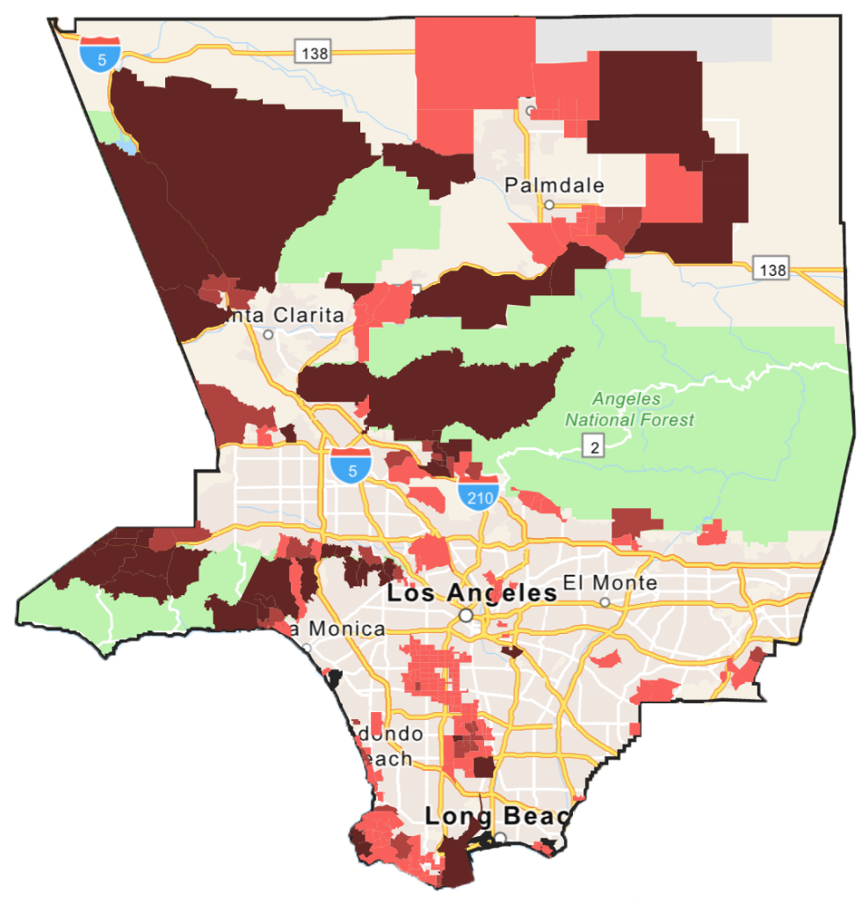
Areas Needing More Meaningful Medi-Cal Dentists
A meaningful dentist is a dentist that: (1) bills Medi-Cal for $10,000 or more per year or (2) provides care to 100+ Medi-Cal patients per year
Using 2017 Medi-Cal data for LA County, the American Dental Association, Health Policy Institute mapped the location of meaningful dentists against the number of Medi-Cal enrollees aged 0-20 years. Census tract level results were used to identify need categories based on the number of Medi-Cal enrollees aged 0-20 per meaningful dentist.
  Substantial need: 4,000+ Medi-Cal enrollees per meaningful dentist
  Moderate need: 3,000-3,999 Medi-Cal enrollees per meaningful dentist
  Some need: 2,000-2,999 Medi-Cal enrollees per meaningful dentist
  Adequate need: <2,000 Medi-Cal enrollees per meaningful dentist
Substantial need
Moderate need
Some need
Data Source: Los Angeles County Department of Public Health Oral Health Program

Slide 87
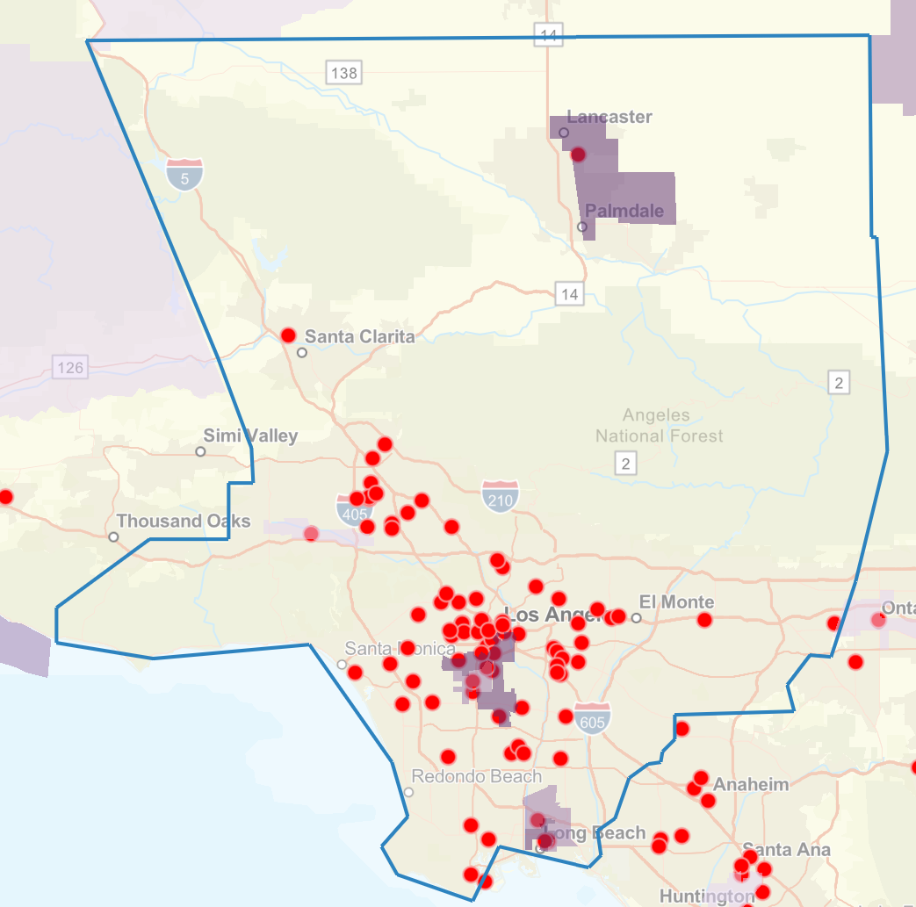
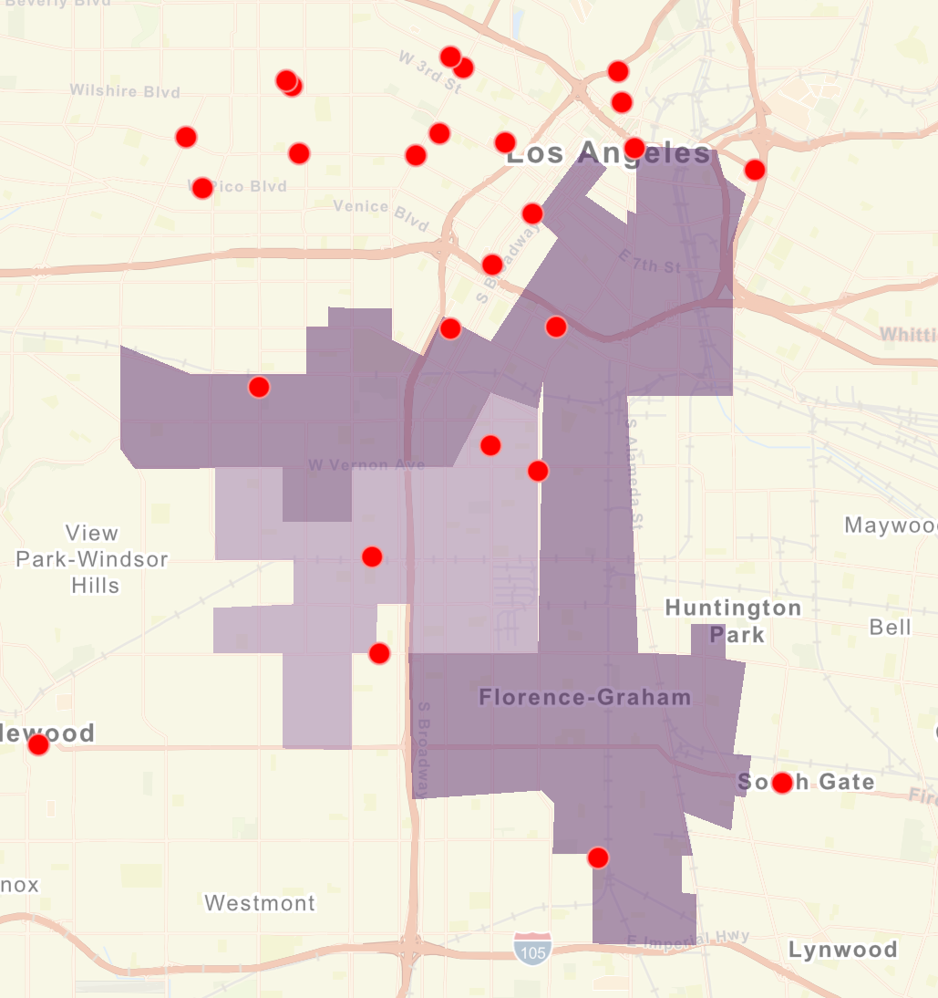
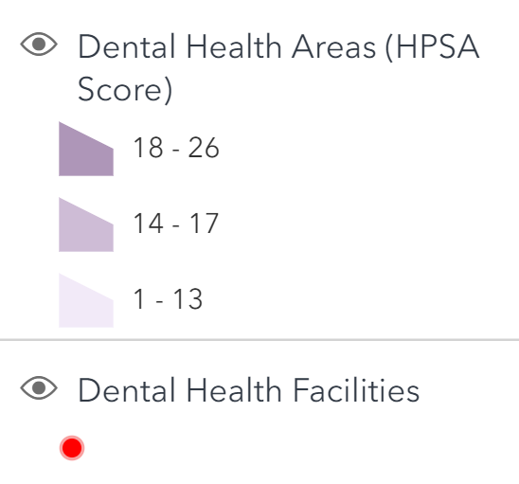
Federally Designated Dental Care Shortage Areas
Federally designated dental care Health Professional Shortage Areas (HPSAs) in LA County, 2026
A dental care Health Professional Shortage Area (HPSA) is a geographic area, population (low-income, homeless, Medicaid) or facility experiencing a shortage of dental care services
4 population HPSAs (purple blocks)
Numerous facility HPSAs (red dots)
Data Source: Health Resources & Services Administration, HRSA Map Tool, https://data.hrsa.gov/maps/map-tool/, generated 04-26-2026

Slide 88

Emergency Department Visits for
Non-Traumatic Dental Conditions

Slide 89
Emergency Department Visits for NTDC
Rate of emergency department (ED) visits for non-traumatic dental conditions (NTDC), 2012-2016 & 2017-2019
The number of ED visits for NTDCs per 100,000 population is lower in LA County than in California
In LA County, the number of ED visits for NTDCs per 100,000 population increased from 2012-2016 to 2017-2019
ED = Emergency department
NTDC = Non-traumatic dental conditions
Data Source: Office of Statewide Health Planning and Development. Analysis provided by California Department of Public Health, Office of Oral Health

Slide 90
ED Visits for NTDCs – LA County Disparities
The rate of ED visits for non-traumatic dental conditions is highest among adults aged 18-34 years of age
Number of ED visits per 100,000 population in LA County by age, sex, and race/ethnicity, 2017-2019
The rate of ED visits for non-traumatic dental conditions is highest among Black/African Americans
Unstable estimate
ED = Emergency department
NTDC = Non-traumatic dental conditions
Data Source: Office of Statewide Health Planning and Development. Analysis provided by California Department of Public Health, Office of Oral Health

Slide 91

Los Angeles County Department of Public Health
Oral Health Program
3530 Wilshire Blvd, Suite 1010
Los Angeles, CA 90010
Phone: (213) 351-1270
Email: oralhealth@ph.lacounty.gov
Web: http://publichealth.lacounty.gov/ohp
Funded by the Office of Oral Health, California Department of Public Health, Contract #22-10173

